Slide 1

Digital Design
With an Introduction to the Verilog HDL, VHDL, and SystemVerilog
6th Edition, Global Edition
Chapter 04
Combinational Logic

Slide 2
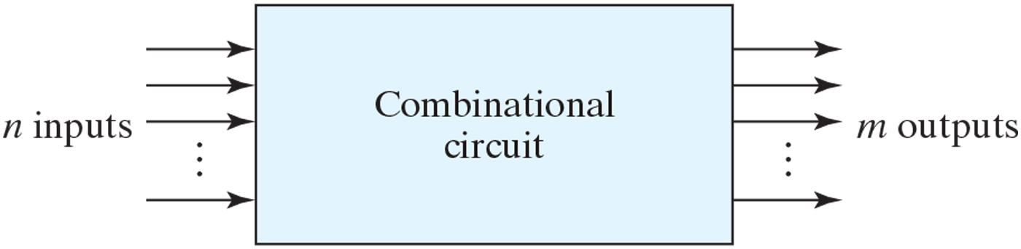
Block diagram of combinational circuit
Outputs are determined by the present inputs only

Slide 3
Analysis Procedure
To determine the function of logic
Analysis procedure
Make sure the logic is combinational or sequential
Obtain the output Boolean functions or the truth table
Boolean function
Label all gate outputs
Make output functions at each level
Substitute final outputs to input variables
Truth table
Put the input variables to binary numbers
Determine the output value at each gate
Obtain truth table

Slide 4
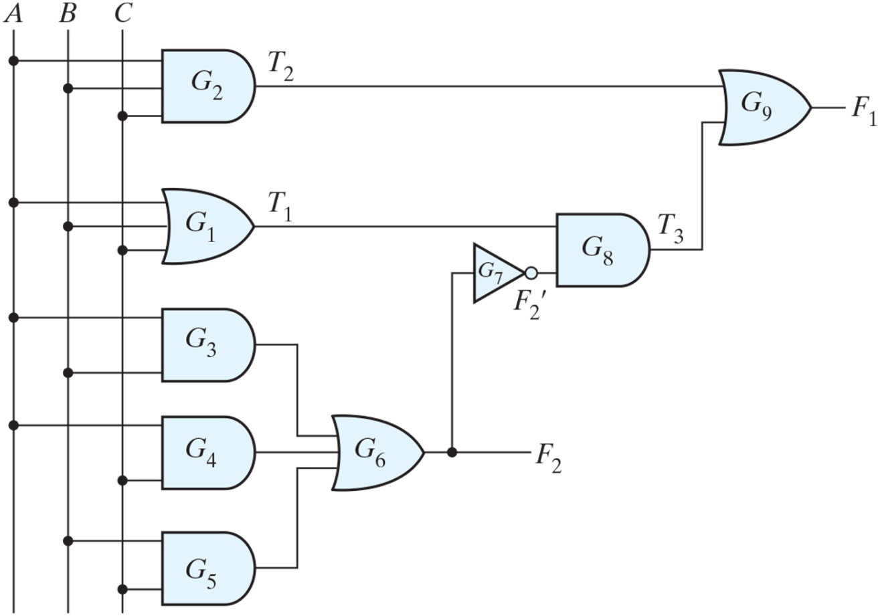
Logic diagram for analysis example
F1= ?

Slide 5
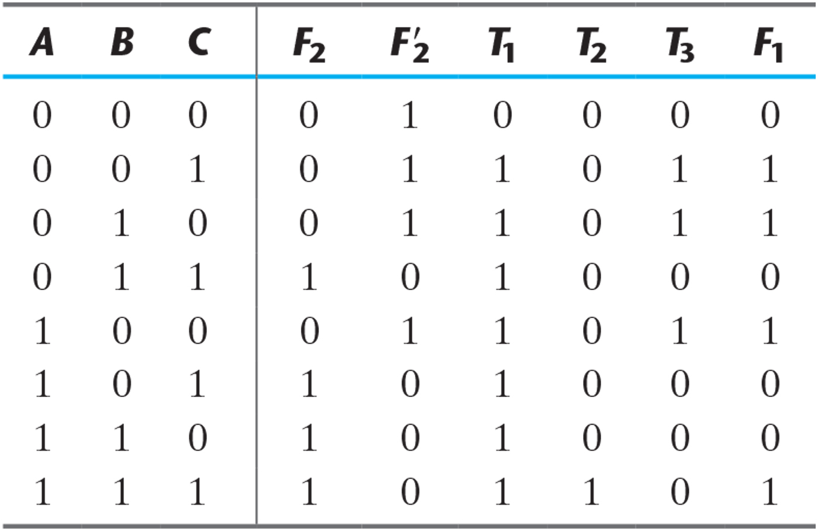
Truth Table for the Logic Diagram of Fig. 4.2 (Previous slide)

Slide 6
Design Procedure
Procedure to design
Determine the required number of input and output from specification
Assign a letter symbol to each input/output
Derive the truth table
Obtain the simplified Boolean functions
Draw the logic diagram and verify design correctness

Slide 7
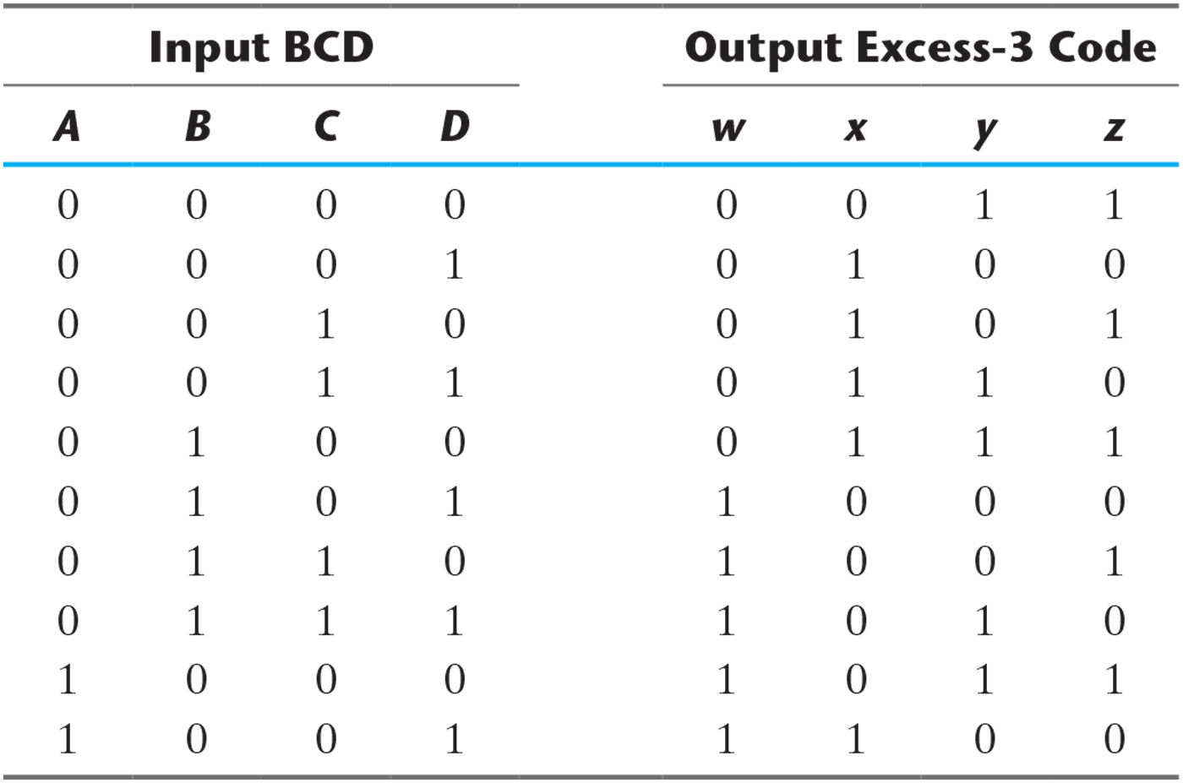
Truth Table for Code Conversion Example

Slide 8
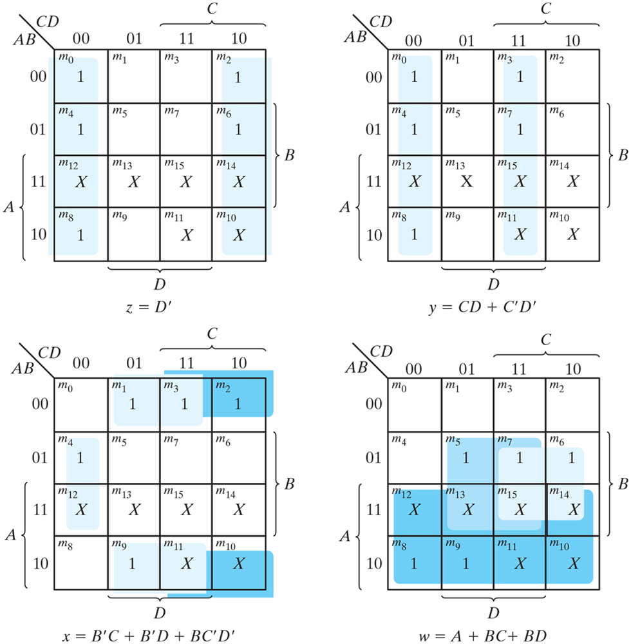
Maps for BCD-to-excess-3 code converter

Slide 9
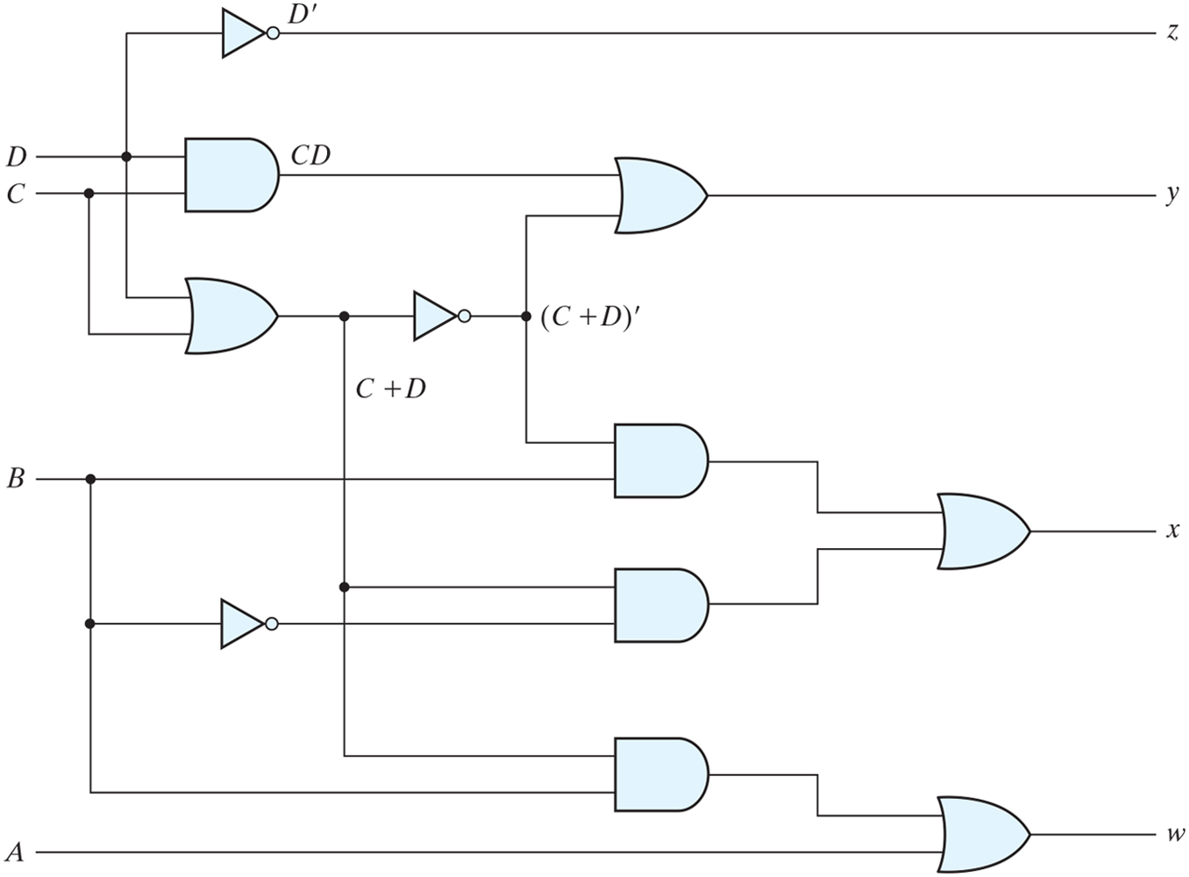
Logic diagram for BCD-to-excess-3 code converter

Slide 10
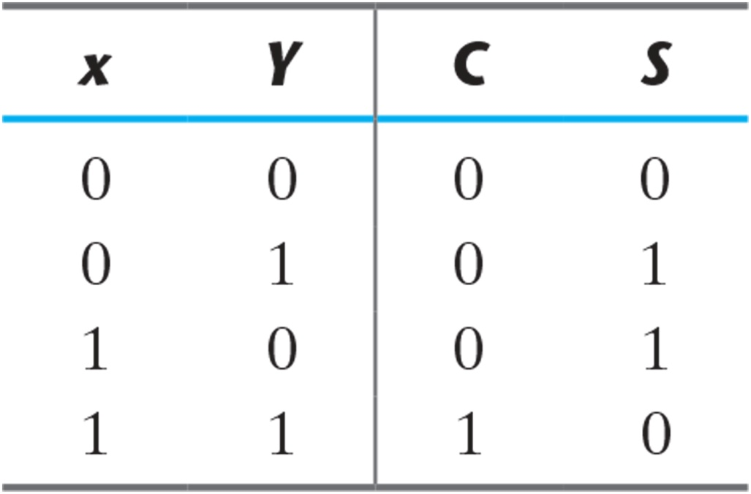
Half Adder
Sum of 2 binary inputs
Input : X(augend), Y(addend)
Output : S(sum), C(carry)
S=xy′+x′y
C=xy

Slide 11
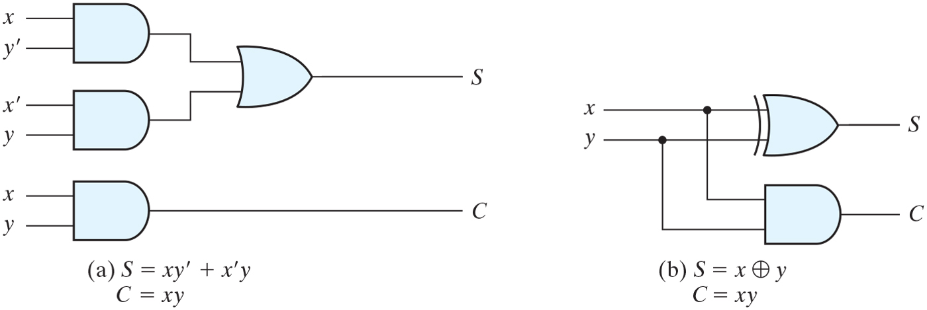
Implementation of half adder

Slide 12
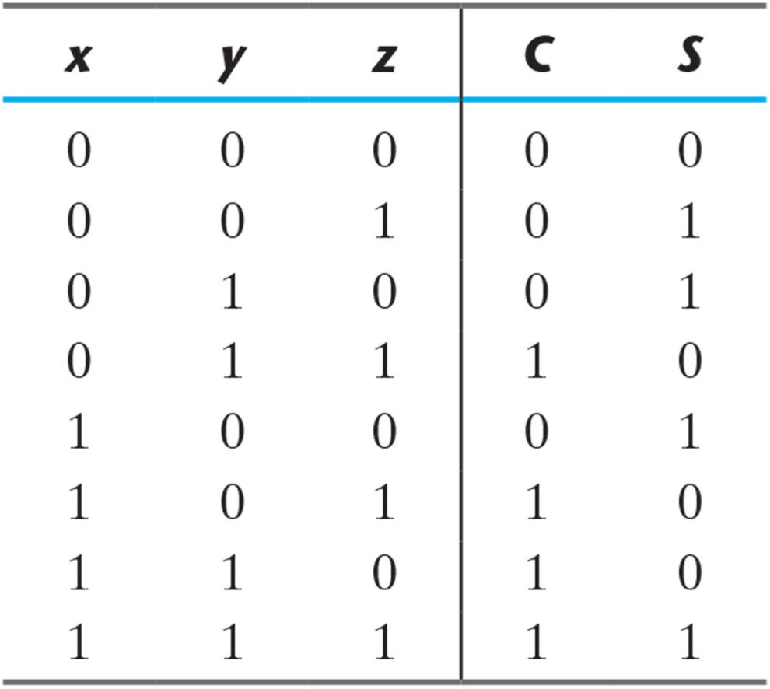
Full Adder
Sum of 3 binary inputs
Input : X,Y(2 significant bits),Z(1 carry bit)
Output : S(sum),C(carry)

Slide 13
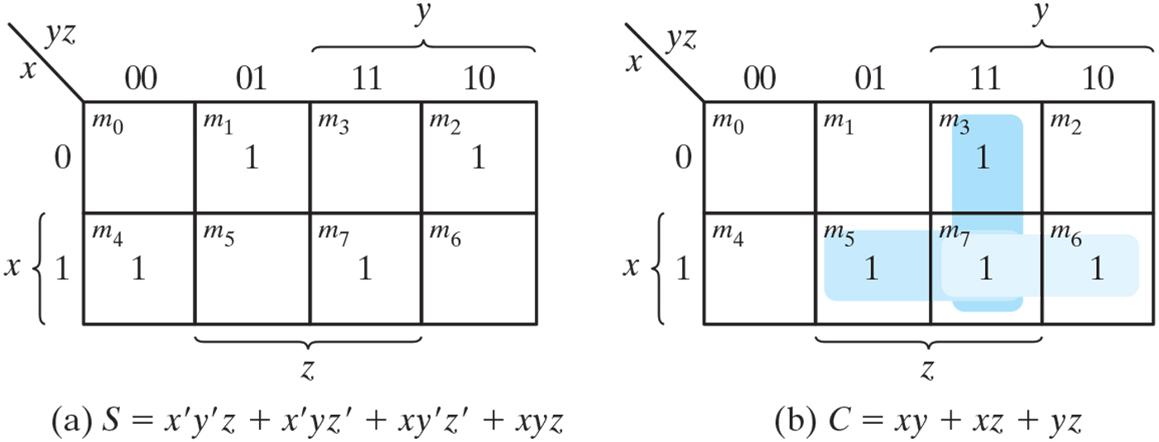
K-Maps for full adder

Slide 14
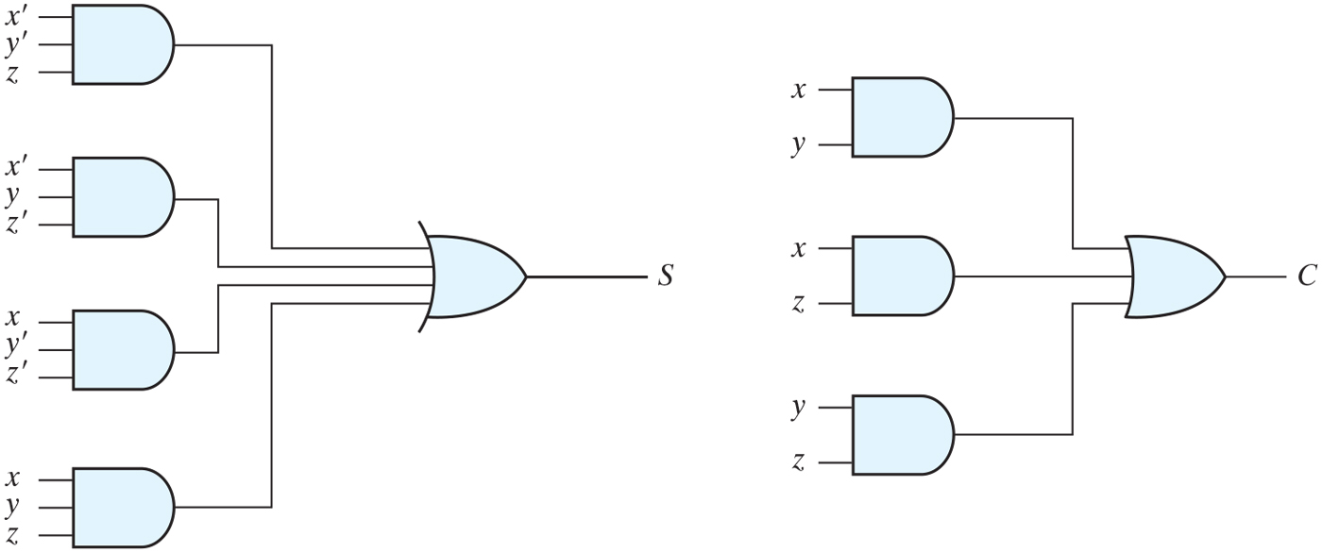
Implementation of full adder in sum-of-products form

Slide 15
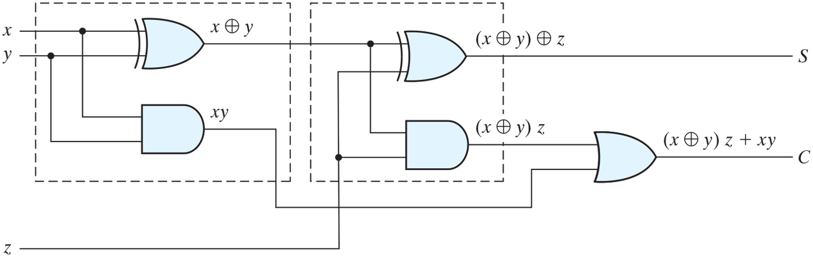
Implementation of full adder with two half adders and an OR gate

Slide 16
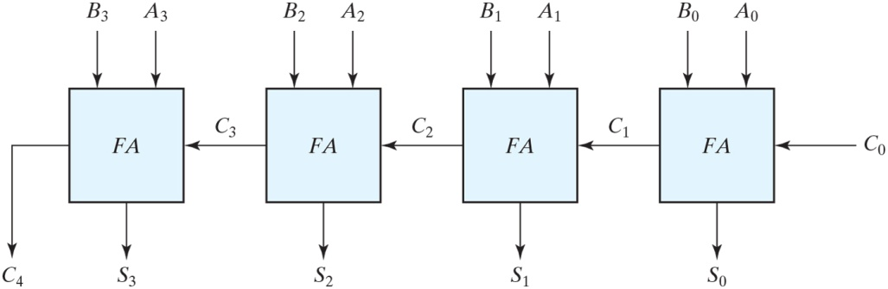
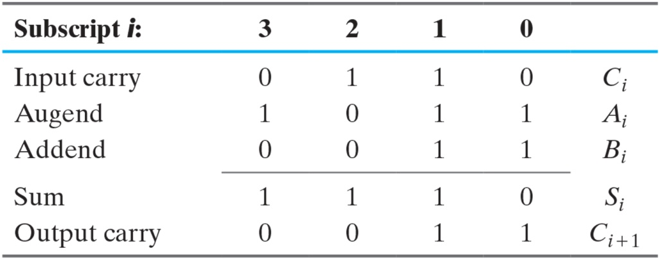
Four-bit adder

Slide 17
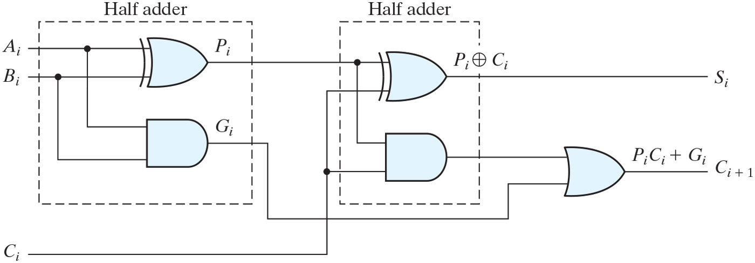
Full adder with P and G shown
Delay time increase (carry delay)
One solution is carry lookahead
All carry is a function of Pi,Gi and C0

Slide 18
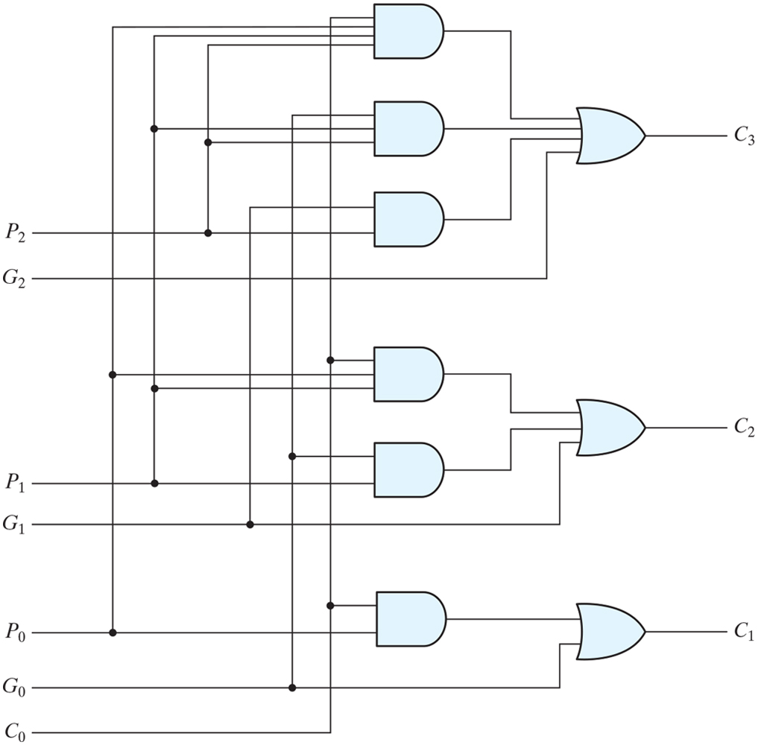
Logic diagram of carry lookahead generator

Slide 19
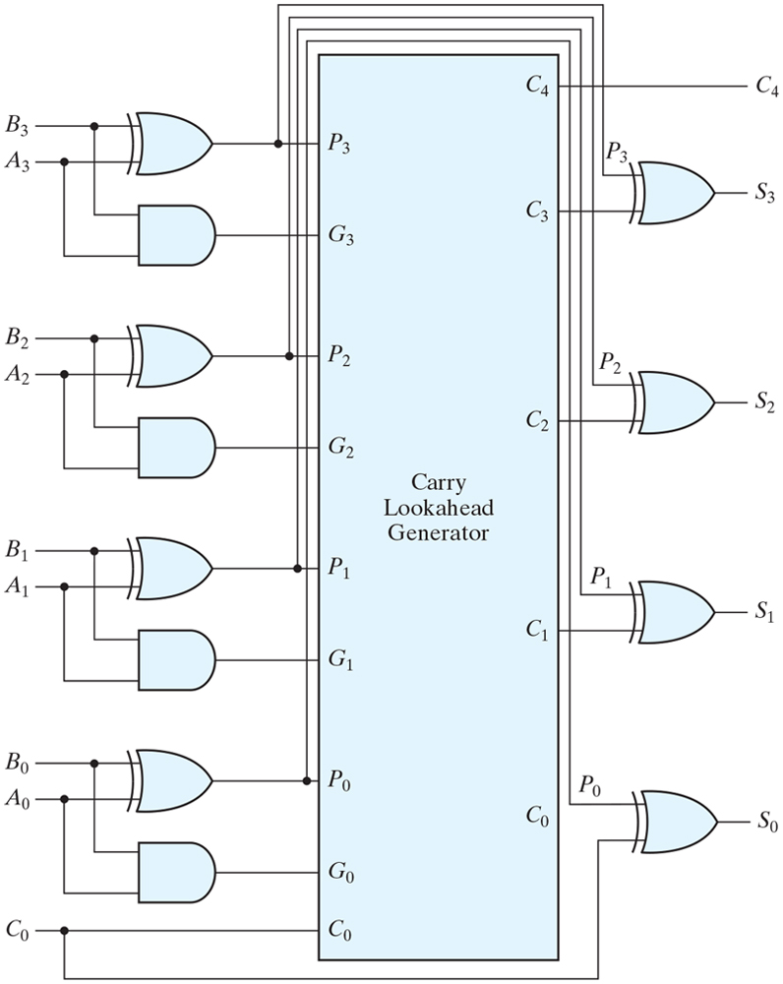
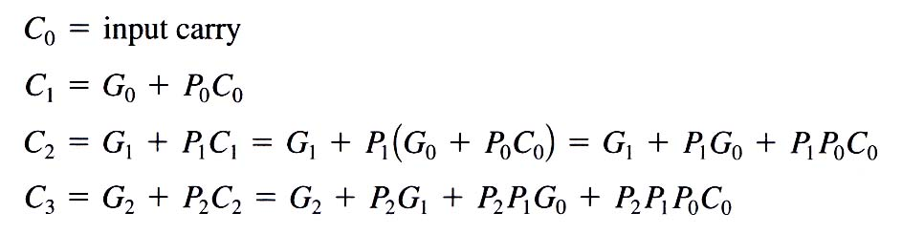
Four-bit adder with carry lookahead

Slide 20
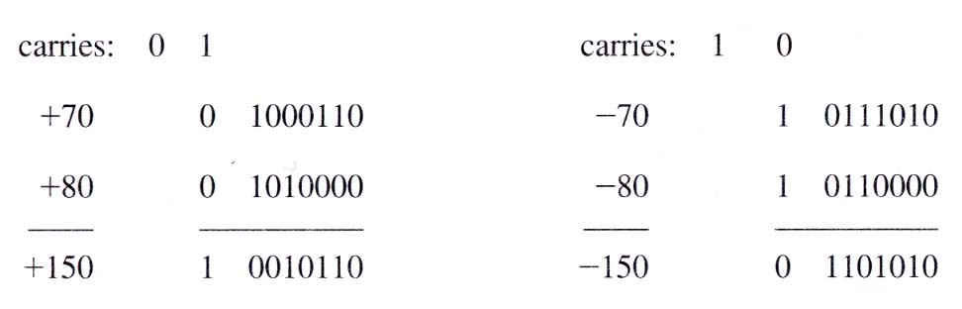
Overflow
Sum of n digit number occupies n+1digit
Occurs when two numbers are same sign
(examples of overflow)

Slide 21
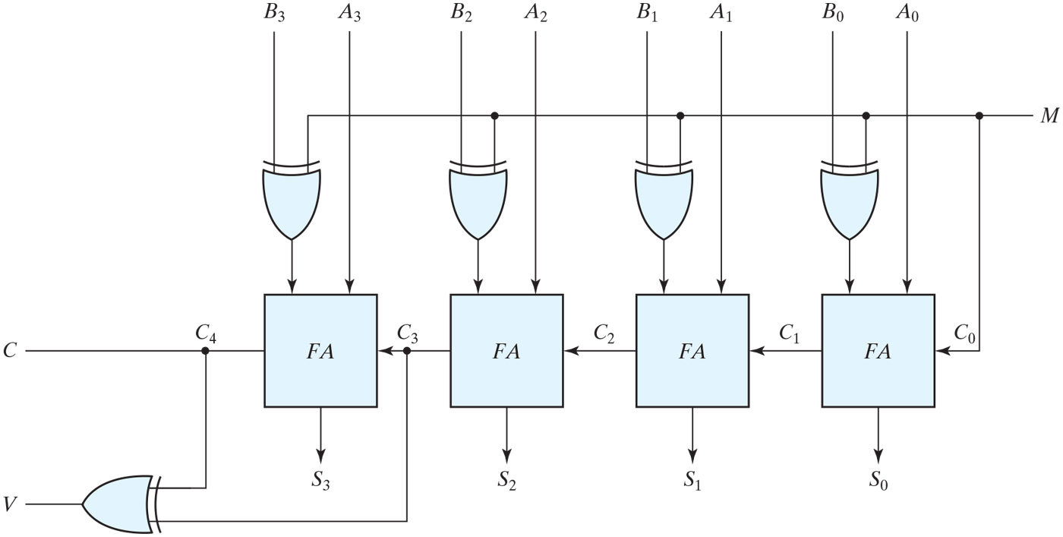
Four-bit adder–subtractor (with overflow detection)

Slide 22
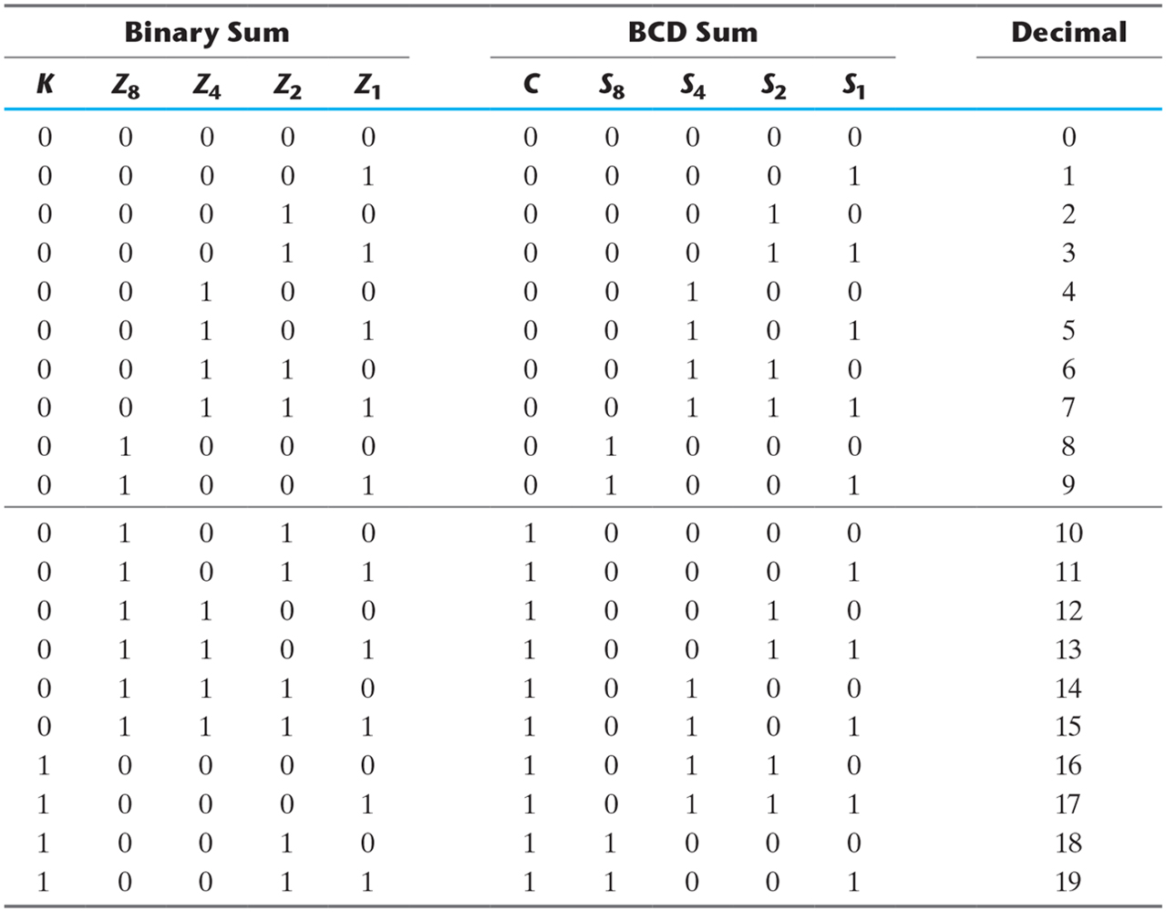
Derivation of BCD Adder

Slide 23
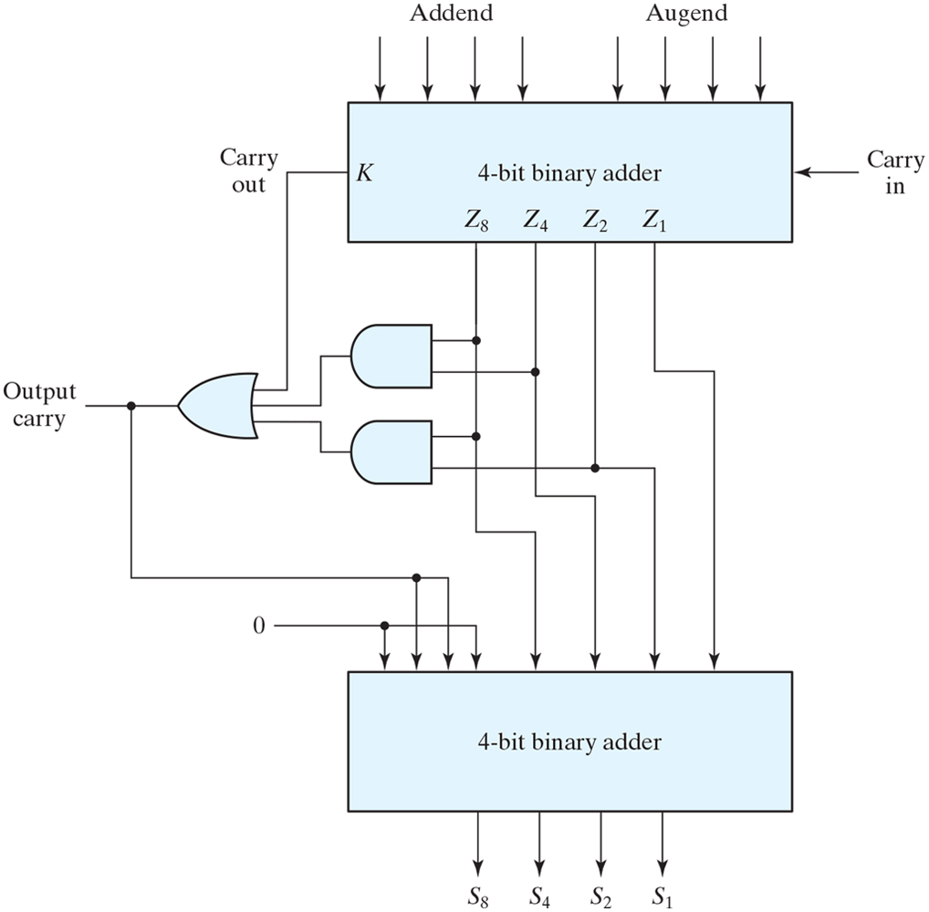
Block diagram of a BCD adder
BCD digit output of 2-BCD digit sum
Carry occurs if output 1010~1111
C=K+Z8Z4+Z8Z2
1100
1101
1110
1111
1010
1011

Slide 24
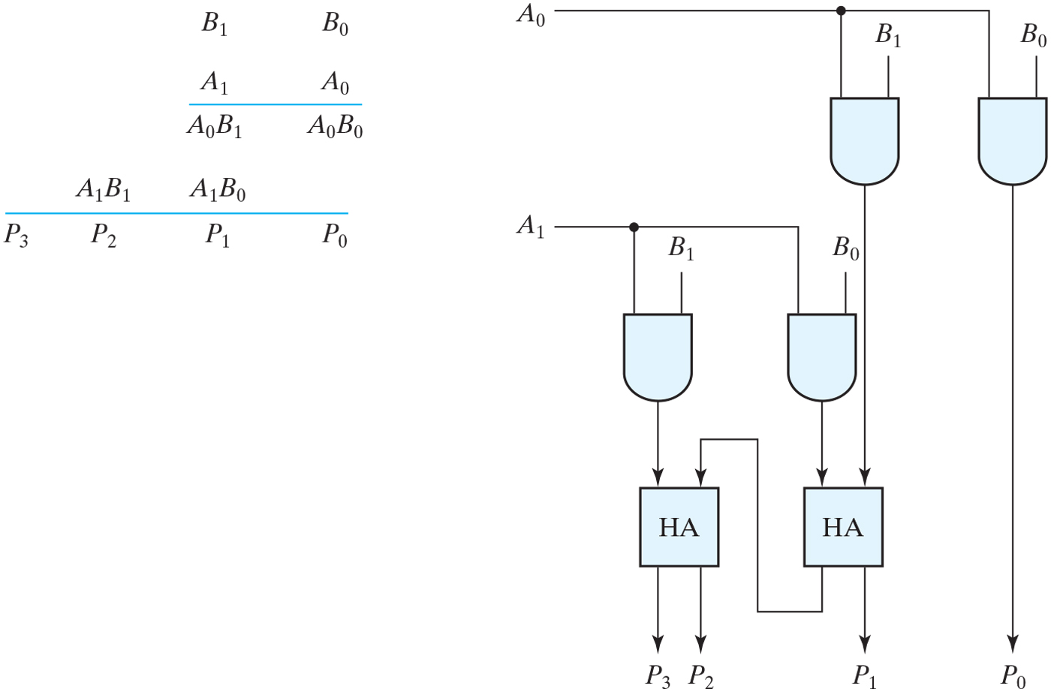
Two-bit by two-bit binary multiplier

Slide 25
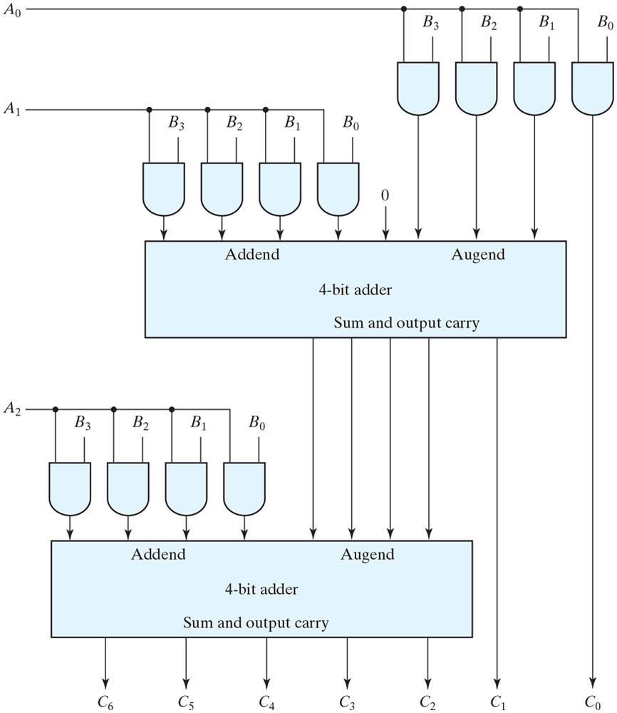
Four-bit by three-bit binary multiplier

Slide 26
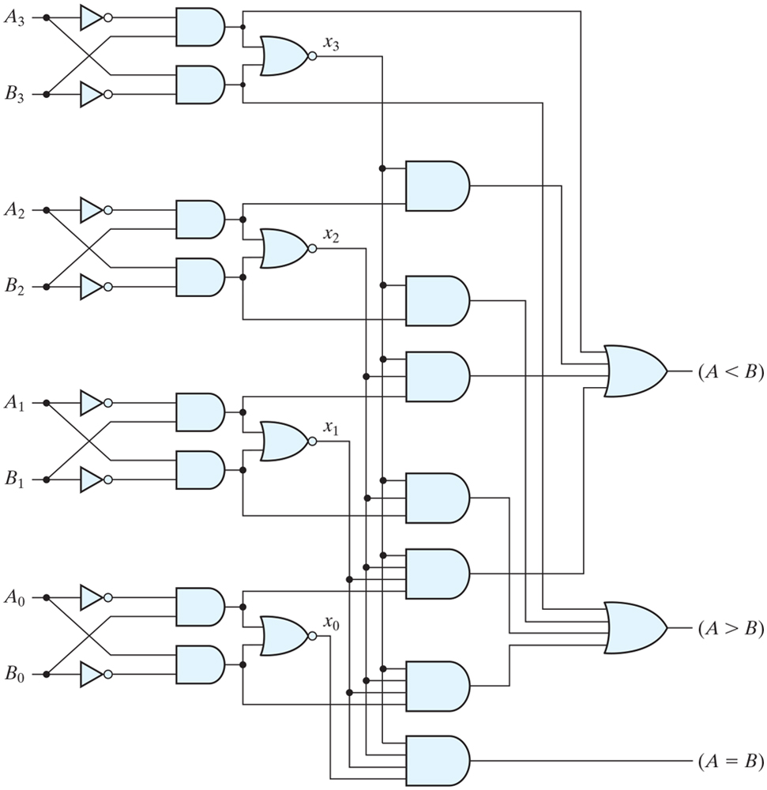
Four-bit magnitude comparator

Slide 27
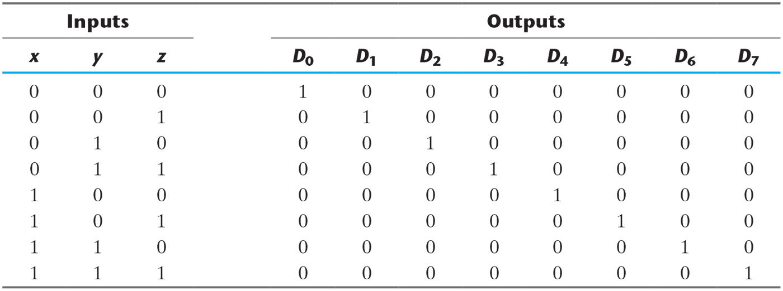
Decoder
Generate the 2ⁿ(or less) minterms of n input variables
Eg)3 to 8 line decoder

Slide 28
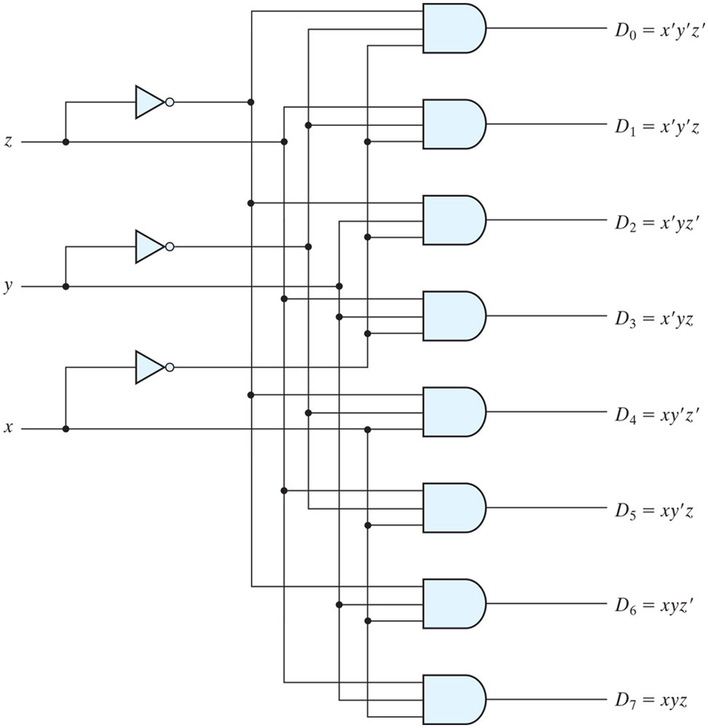
Three-to-eight-line decoder

Slide 29
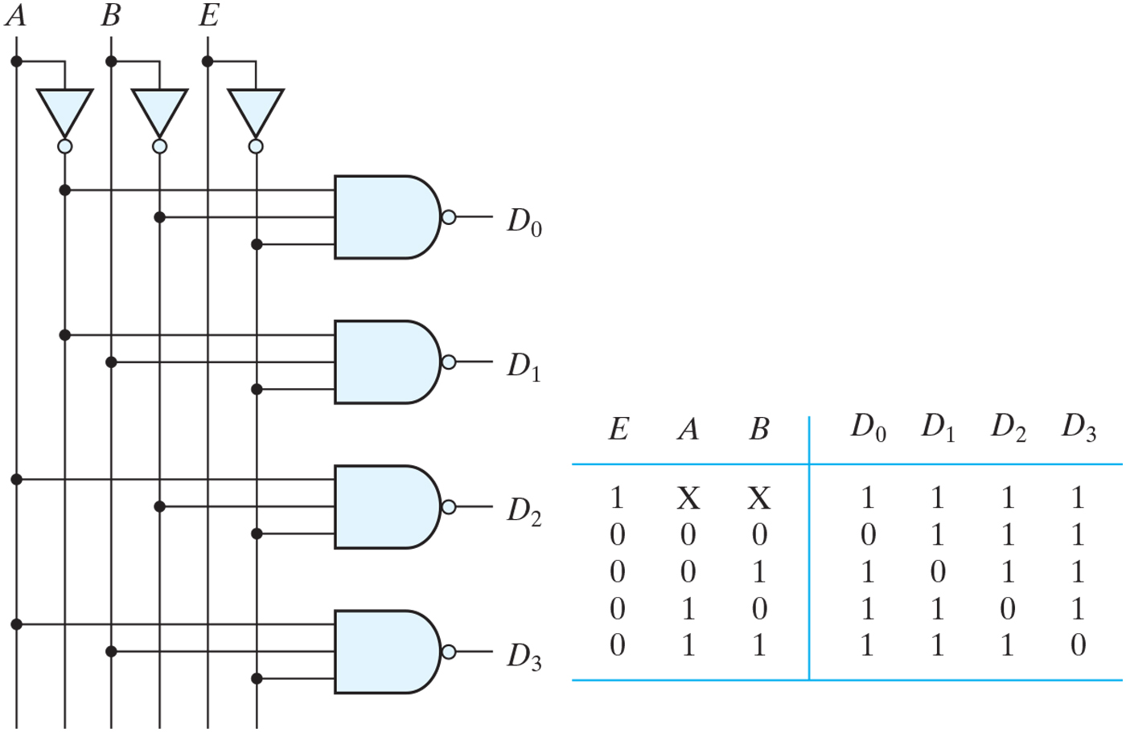
Two-to-four-line decoder with enable input

Slide 30
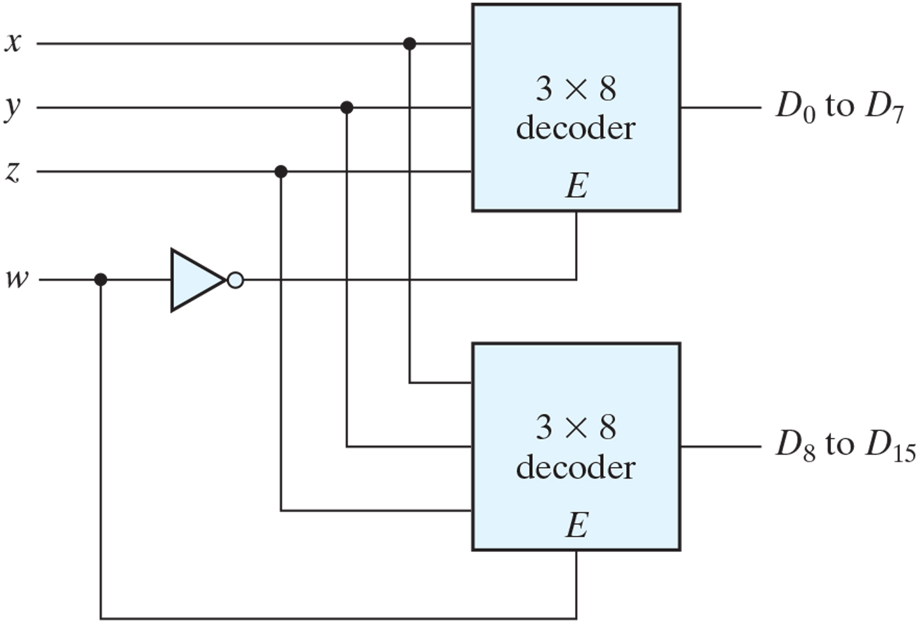
4 x 16 decoder constructed with two 3 x 8 decoders

Slide 31
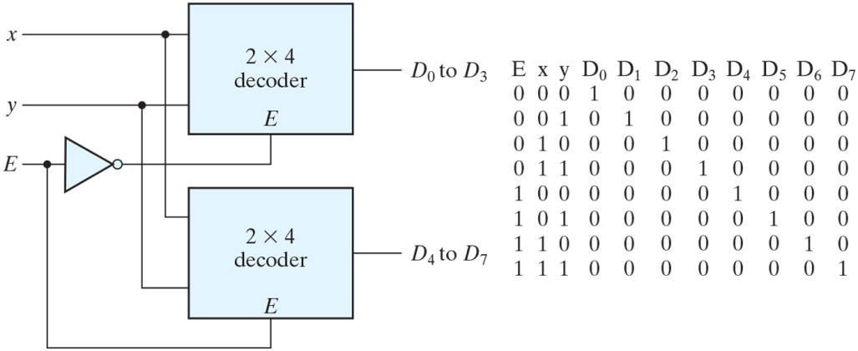
Figure PE4.8

Slide 32
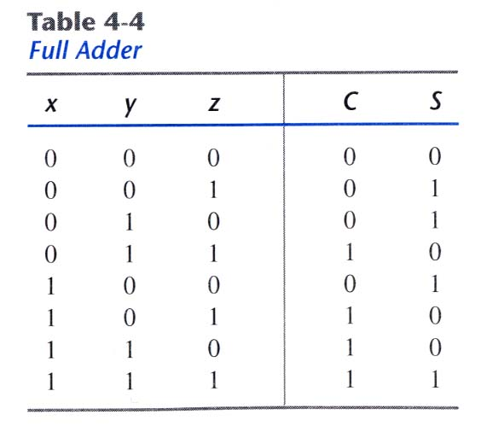
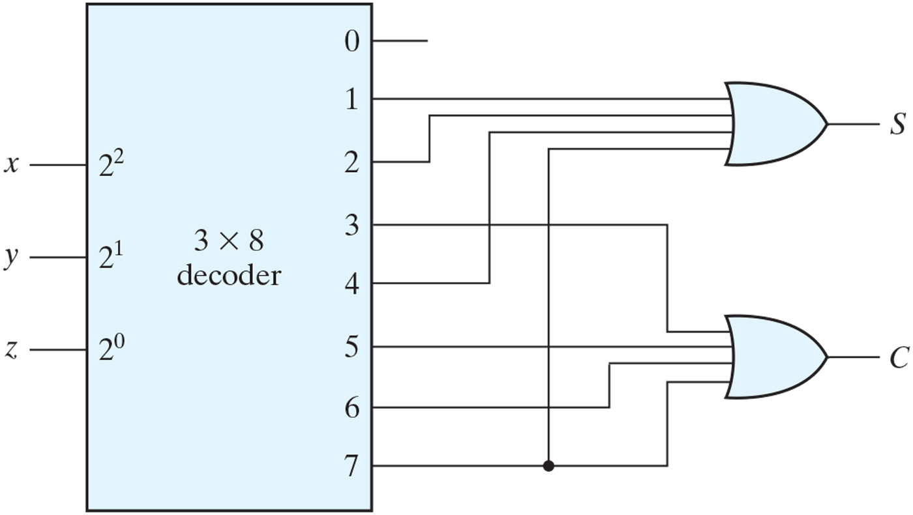
Implementation of a full adder with a decoder

Slide 33
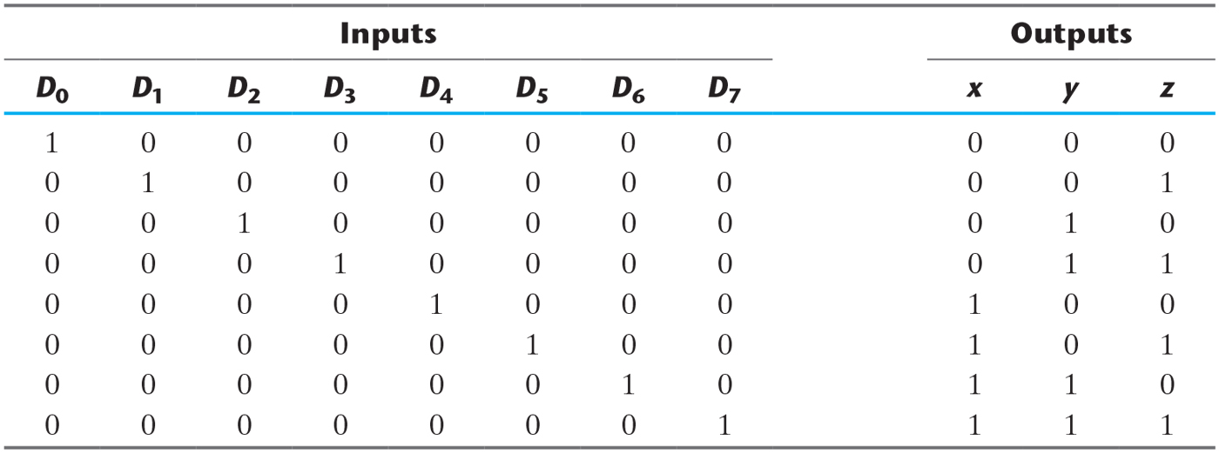
Encoder
Inverse operation of a decoder
Generate n outputs of 2ⁿ input values
Eg) octal to binary encoder

Slide 34
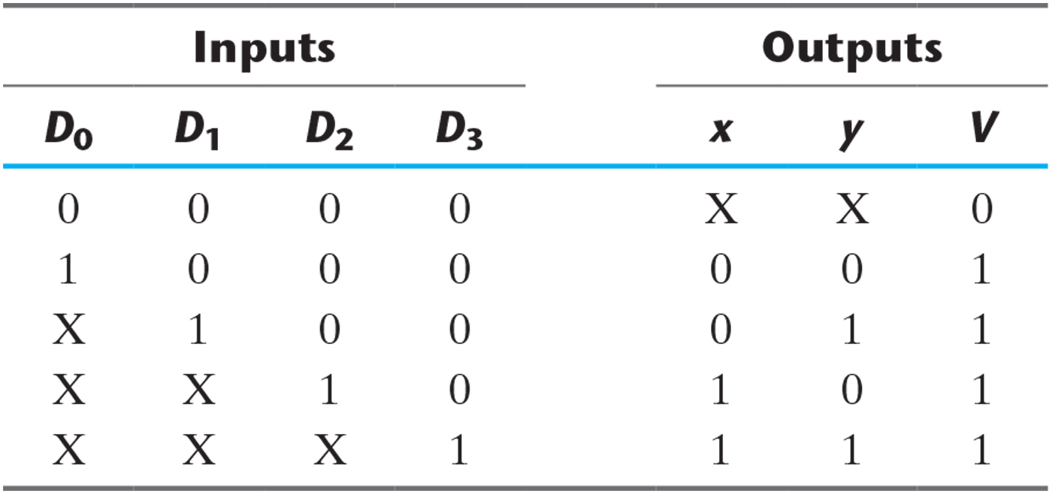
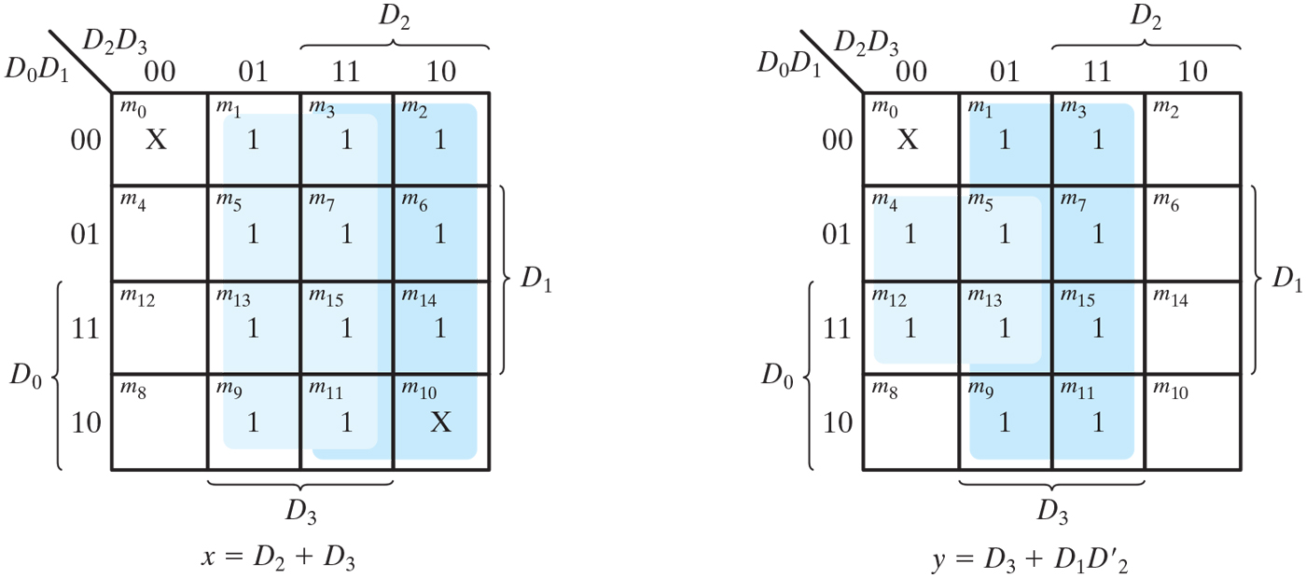
Truth Table of a Priority Encoder

Slide 35
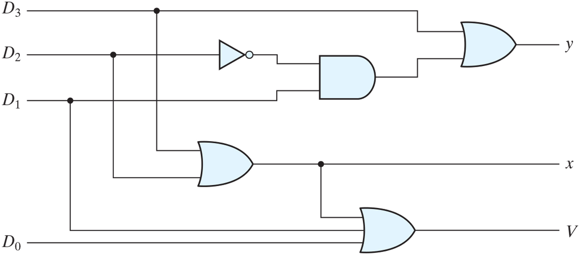
Four-input priority encoder

Slide 36
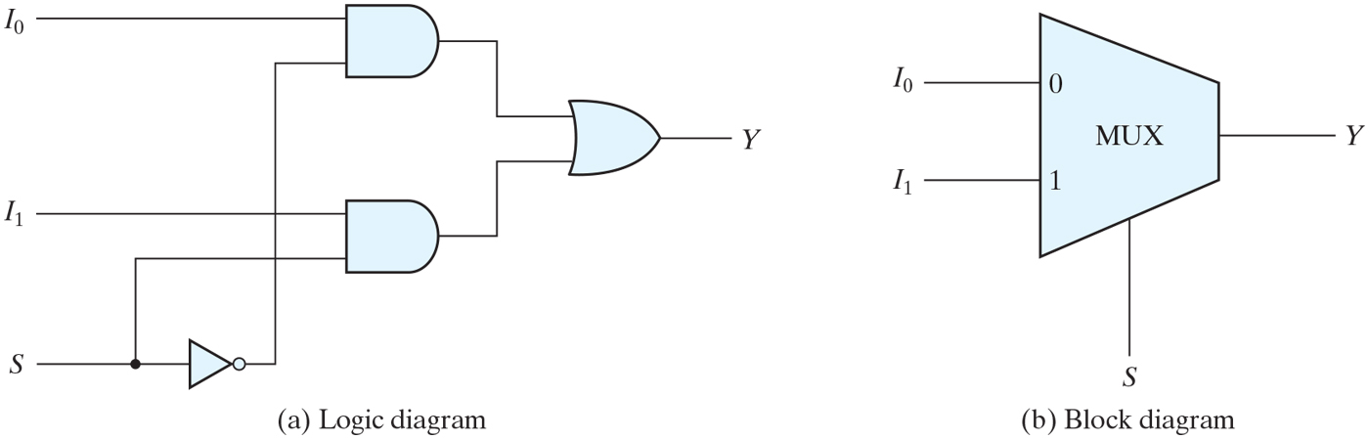
Multiplexer (MUX)
Select a binary information from many input lines
Selection is controlled by a set of selection lines
2ⁿ input lines have n selection lines

Slide 37
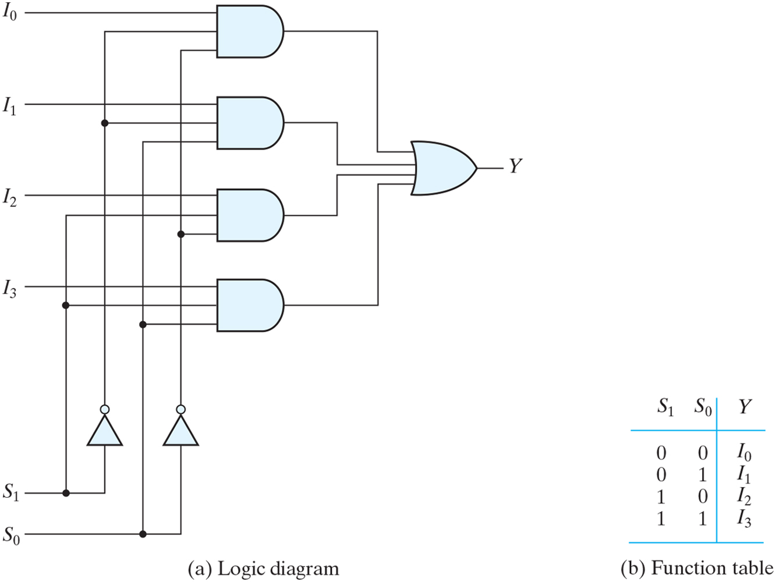
Four-to-one-line multiplexer

Slide 38
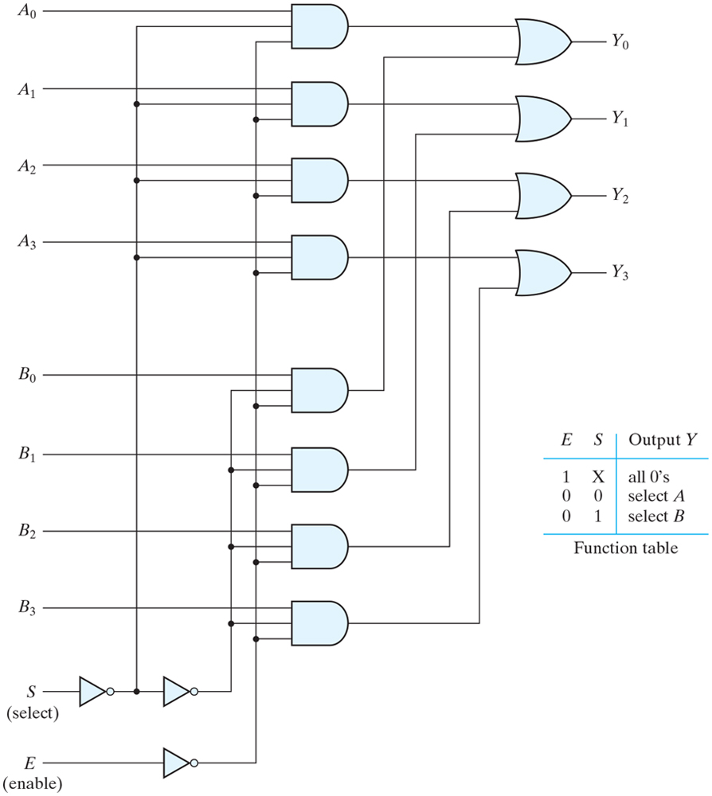
Quadruple two-to-one-line multiplexer

Slide 39
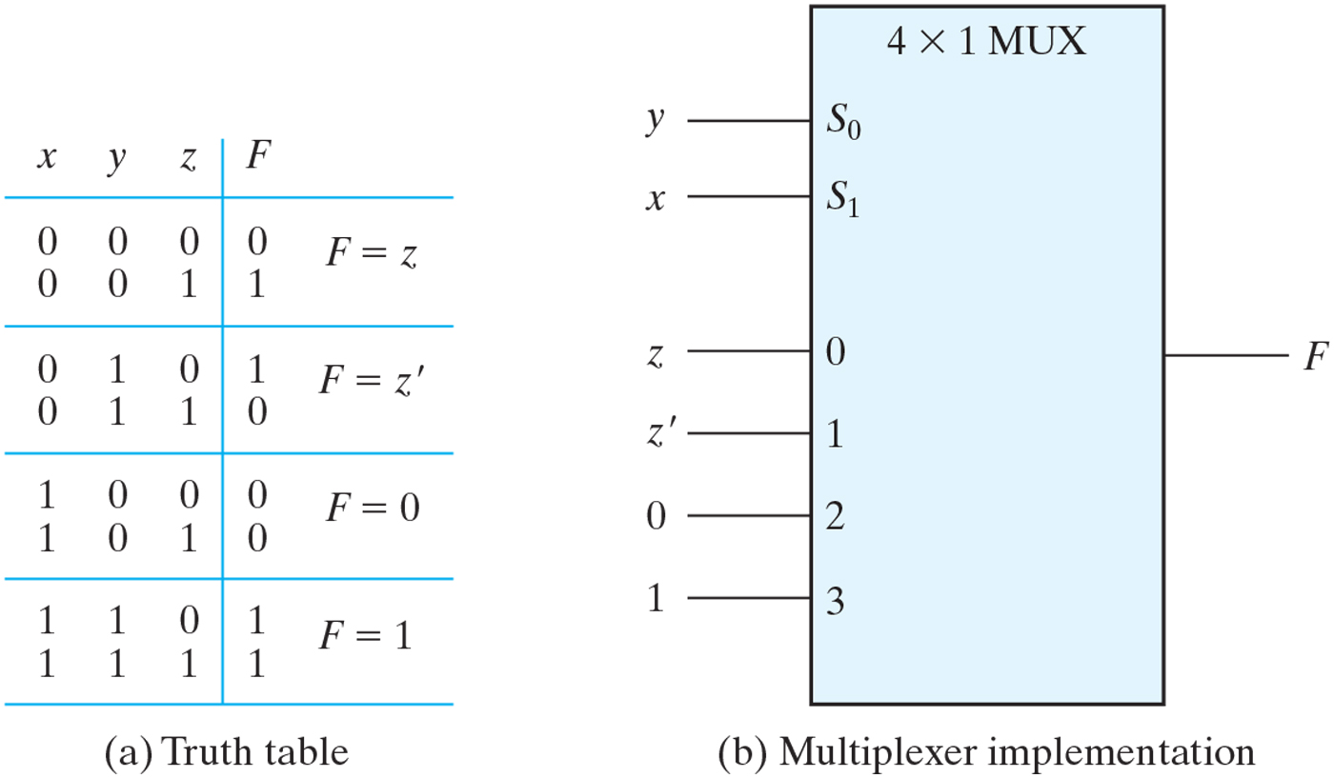
Implementing a Boolean function with a multiplexer
Minterms of function are generated in a MUX
n input variables, n-1 selection input

Slide 40
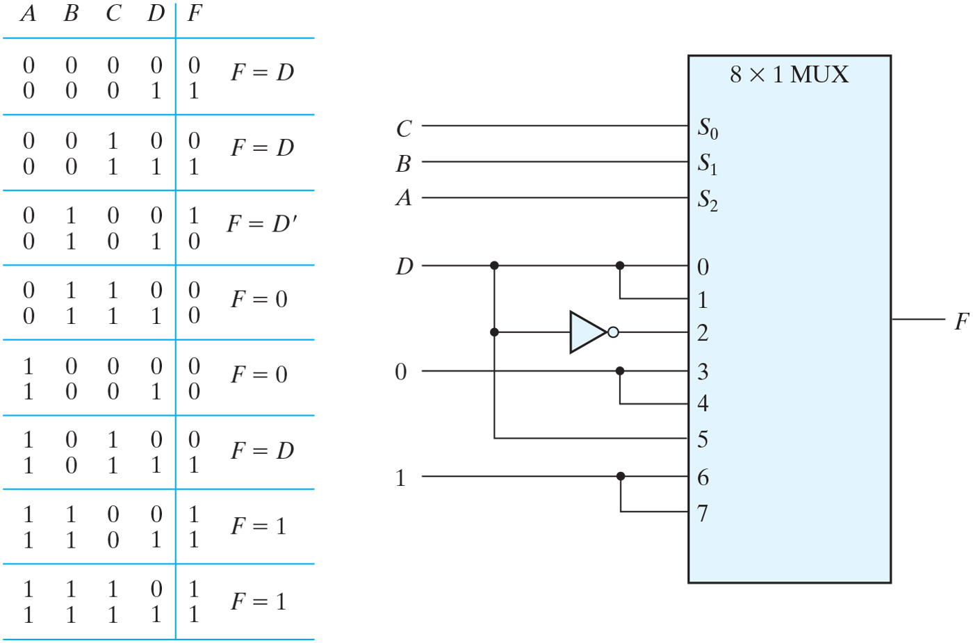
Implementing a four-input function with a multiplexer

Slide 41
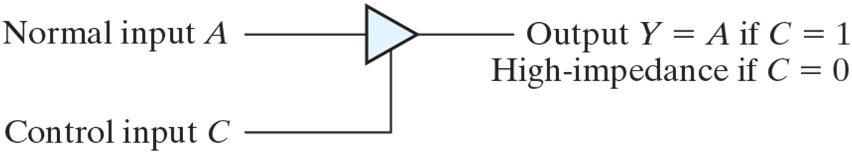
Graphic symbol for a three-state buffer
High-impedance behaves like an open circuit

Slide 42
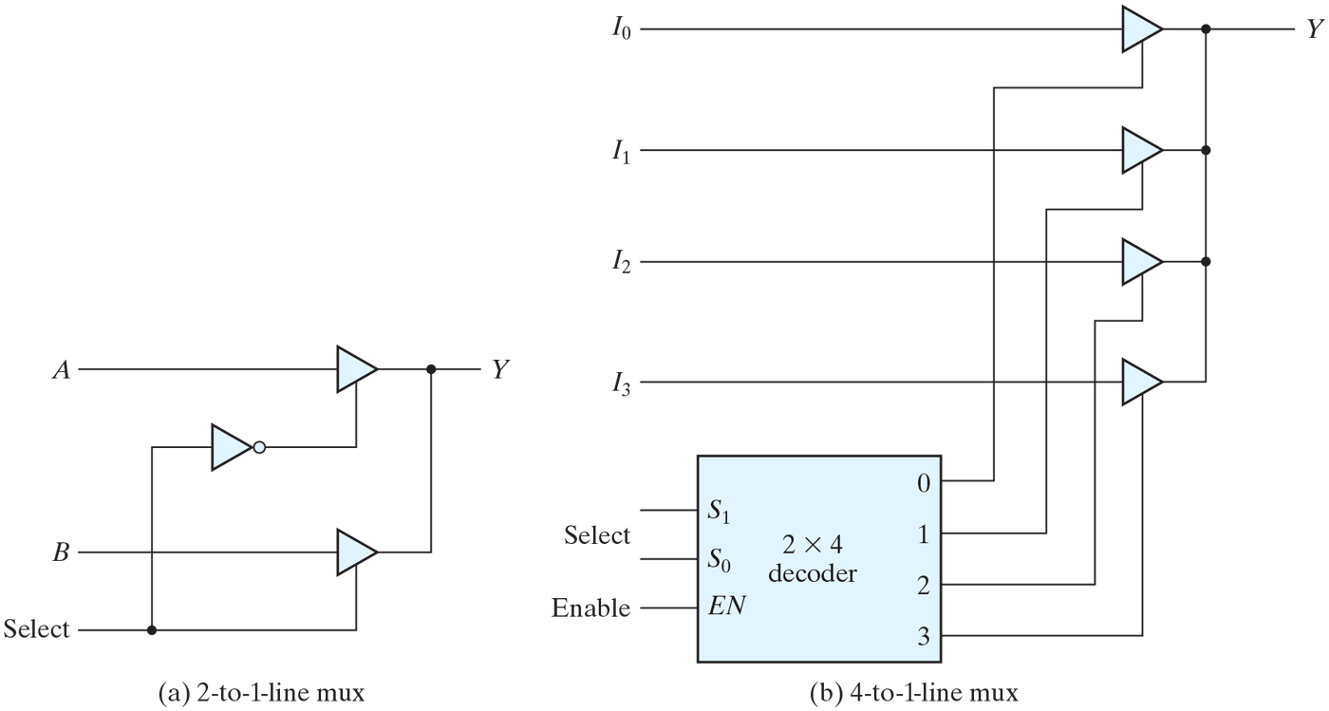
Multiplexers with three-state gates

